Slide 1
Classification Algos compared
Using Kaggle customer demographic/purchasing data
Algos: logistic regression, random forest, xgboost, k-nearest neighbor

Slide 2
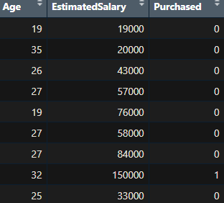
Data and methodology
Rows of age, salary, and 0/1 column for whether they purchased a product or not
Break into train/test at 70/30 split
  Compare each algorithm’s accuracy trained on train data on test data. Which algorithm is most accurate?
Also sensitivity (finding non-purchasers), and specificity (identifying purchasers)
  Depending on use case, we may want to optimize for one or the other

Slide 3
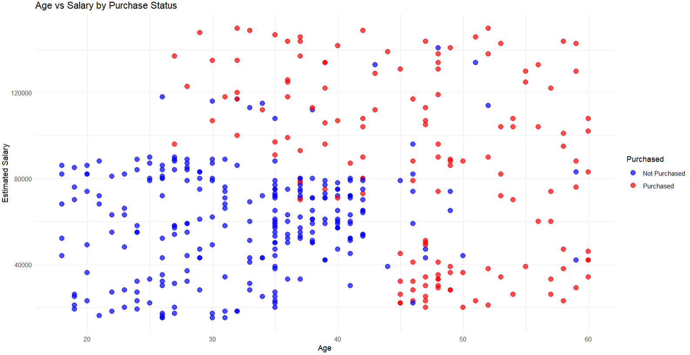
Customer Data
See trend of purchases from richer and older visitors

Slide 4
Algorithms
Logistic Regression - A linear model that estimates the probability of a binary outcome
Random Forest - An ensemble of decision trees built on bootstrapped samples that vote together to improve accuracy and reduce overfitting
XGBoost - A gradient boosting algorithm that builds trees sequentially, optimizing residual errors with regularization for high predictive power
K‑Nearest Neighbor (KNN)- method that classifies a point based on the label of its closest training examples
Neural network - a computational model inspired by the brain, made up of interconnected layers of nodes that learn patterns in data through weighted connections and iterative training.

Slide 5
Logistic regression
A linear model that estimates the probability of a binary outcome
Classic model for binary (0 and 1) prediction
Tried 2 variants
  First, using all tunings as default (0.5 threshold)
      Accuracy: 85%
      Sensitivity (finding non-purchasers): 93%
      Specificity (identifying purchasers): 69%
  Second, used ROC Curve to find ideal threshold for more balanced Sensitivity vs Specificity (0.311 threshold)
    The ROC curve is a plot that shows the trade‑off between a classifier’s sensitivity and 1‑specificity across different decision thresholds.
      Accuracy: 84%
      Sensitivity (finding non-purchasers): 84%
      Specificity (identifying purchasers): 84%
    Worth it to get more balance in errors

Slide 6
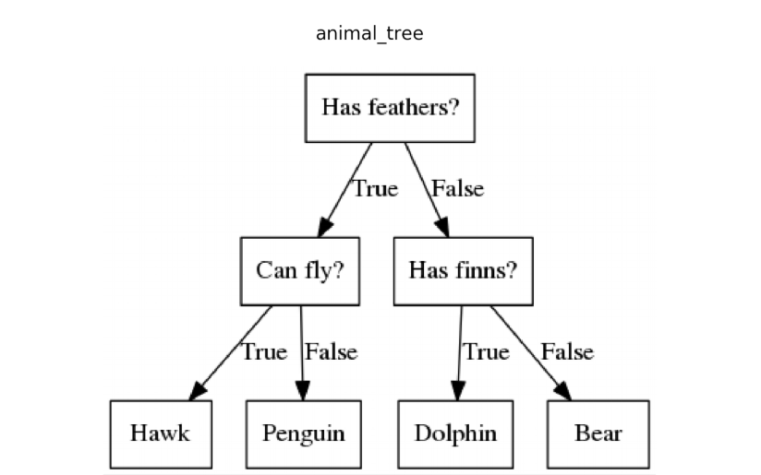
Random Forest
An ensemble of decision trees built on bootstrapped samples that vote together to improve accuracy and reduce overfitting
  Accuracy: 93.33%
  Sensitivity (finding non-purchasers): 93%
  Specificity (identifying purchasers): 95%

Slide 7
XGBoost
A gradient boosting algorithm that builds trees sequentially, optimizing residual errors with regularization for high predictive power Accuracy: 91.7%
  Sensitivity (finding non-purchasers): 93%
  Specificity (identifying purchasers): 90%

Slide 8
XGBoost performance boost
2 variants on default XGBoost
  Let’s determine ideal number of rounds
    Each new round in XGBoost corrects errors from the last round
      Early rounds capture general rules
      Too many rounds can lead to overfitting (on noise perhaps) etc
    Optimal rounds, accuracy .933, sensitivity .92, specificity .95
  Let’s optimize parameters generally
    Use “Grid” approach and auto run 49 variants (7x7 params) to optimize accuracy
    accuracy .933, sensitivity .93, specificity .95
      Barely better (.01 improvement on sensitivity)
      But still cool

Slide 9
K Nearest Neighbor
Method that classifies a point based on the label of its closest training examples
  The “k” refers to how many similar points to use
    Small k could be oversensitive to noise, larger k could miss important differences
    R can choose ideal k for accuracy
  Default
    Accuracy: 0.83, sensitivity 0.94, specificity, 0.59
  Scaled
    This algo works best when features have same numerical range, but our data (Age and salary) are at very different scales, so let’s put them both to variations of 0-1
    Accuracy: 0.91, sensitivity 0.93, specificity, 0.90
    Much better!

Slide 10


Neural Networks
A computational model inspired by the brain, made up of interconnected layers of nodes that learn patterns in data through weighted connections and iterative training
Kind of overkill for this simple dataset tbh
But… it’s still worth a try

Slide 11
Neural Networks – 2 approaches
Native r version (neuralnet), runs in r locally, most for educational purposes
  Accuracy: 0.85, sensitivity 0.80, specificity, 0.92
  Not great!
Keras version – uses Python TensorFlow API integration
  Accuracy: 0.93, sensitivity 0.97, specificity, 0.87
  Very powerful

Slide 12
Algorithms compared
Algorithm | Accuracy | Sensitivity | Specificity | Rank
Logistic regression (default threshold 0.5) | .85 | .93 | .69 | 8
Logistic regression (ideal threshold 0.311) | .85 | .84 | .84 | 6
Random Forest (default tuning) | .933 | .93 | .95 | 1 (tied)
XGBoost (default) | .917 | .93 | .9 | 4
XGBoost (ideal number of rounds) | .933 | .92 | .95 | 2
XGBoost (more ideal params) | .933 | .93 | .95 | 1 (tied)
K-nearest Neighbor (default) | .83 | .94 | .59 | 9
K-nearest Neighbor (scaled) | .91 | .93 | .90 | 5
Neural network (just R) | .85 | .80 | .92 | 7
Neural network (Tensorflow API) | .933 | .97 | .87 | 3

Slide 13
Conclusion
Random Forest, XGBoost and the Keras Neural Network are all nearly identical in high performance
  Likely due to simplicity of 2 features and relatively small dataset
    In larger and more complex datasets, more daylight would likely appear and XGBoost and NN might outperform RF
  In this case, XGBoost and Random Forest does have benefit of running natively in r and being most explainable (RF slightly more than XGB)

